Slide 1
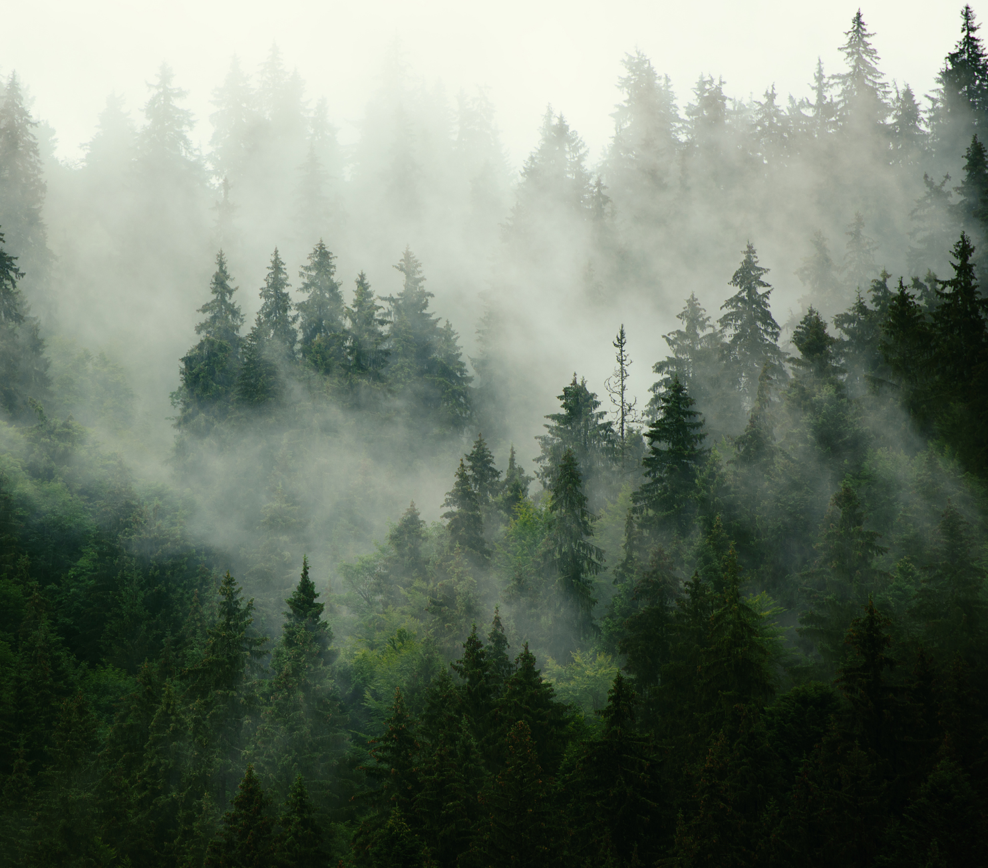
Forest Cover Type Prediction
Thomas Dupuy

Slide 2
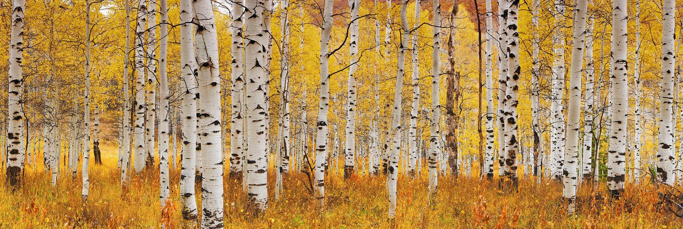
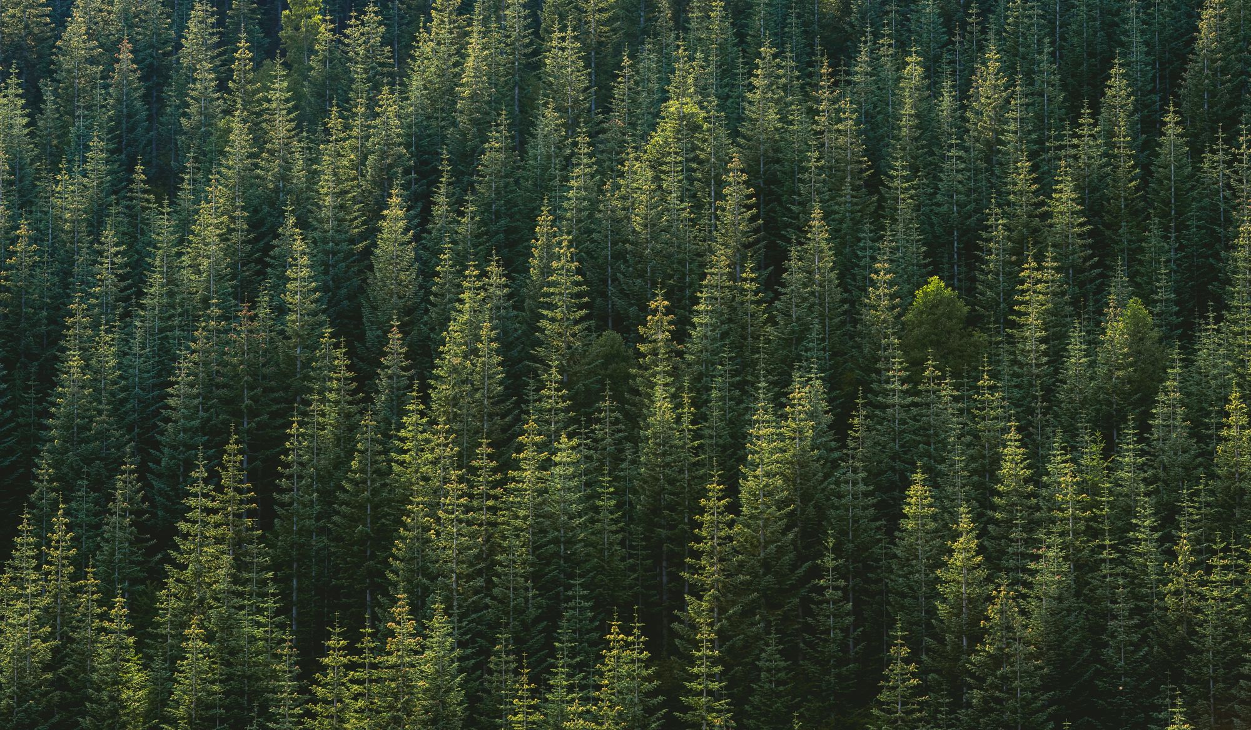
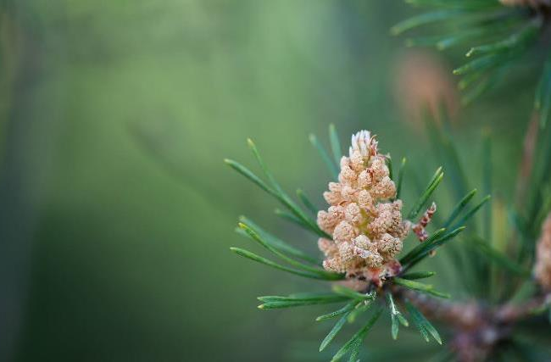
Introduction
Predict the forest cover type, or most common tree type, in a 30m-by-30m aera when given cartographic features of the aera. Such features include elevation, slope, distance to water, lighting, soil type, and more. There are 7 cover types for the model to choose from and 12 features per square area.

Slide 3
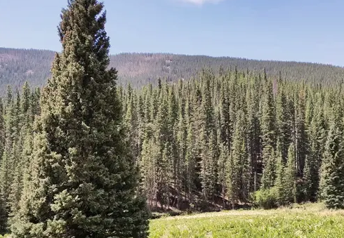
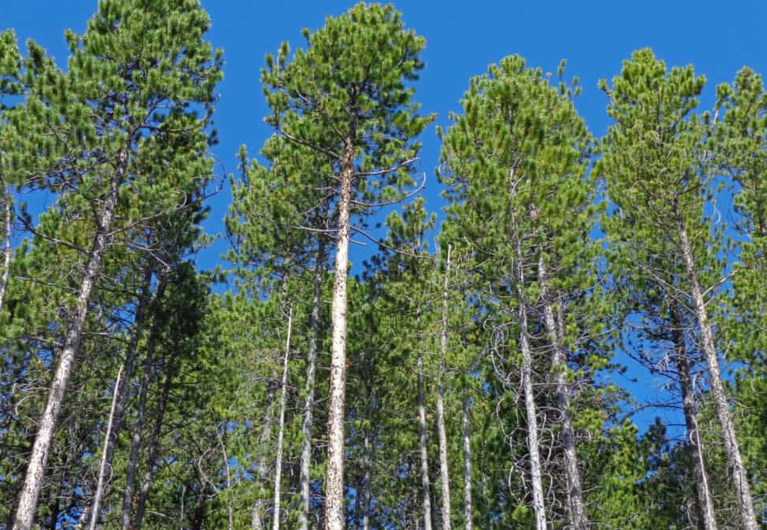
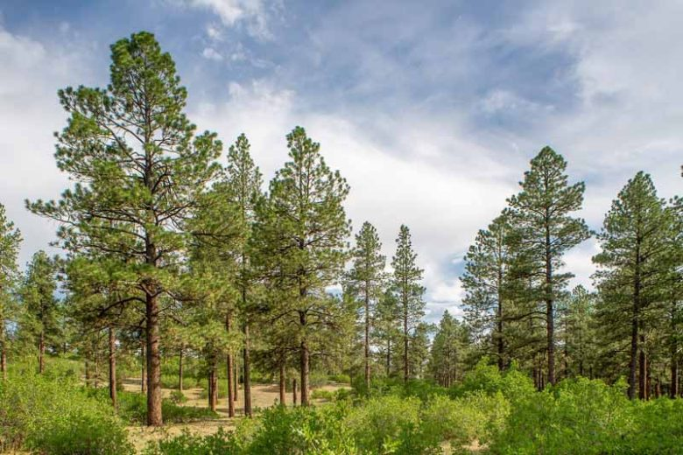
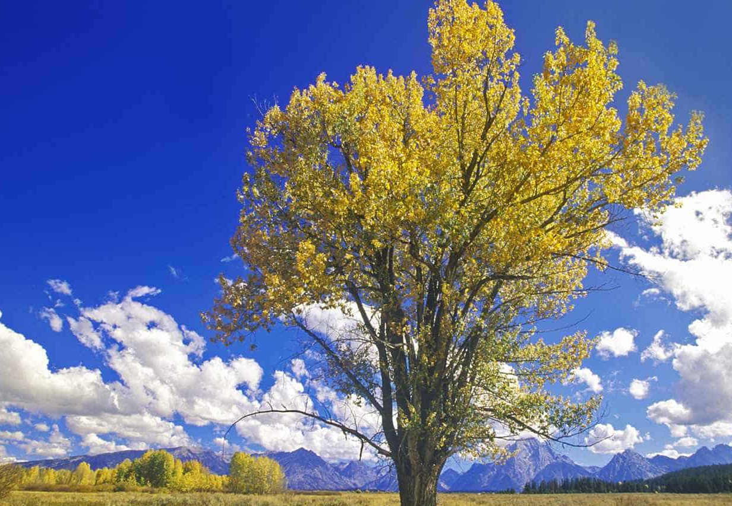
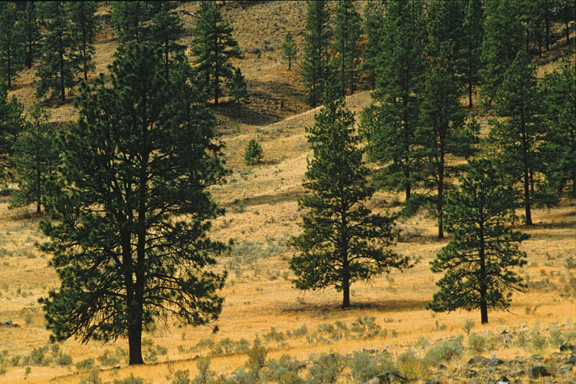
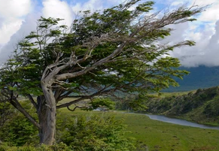
Cover Types
Spruce/Fir (1)
Lodgepole Pine (2)
Ponderosa Pine (3)
Cottonwood/Willow (4)
Aspen (5)
Douglas-fir (6)
Krummholz (7)

Slide 4
Class Distribution

Slide 5
Data Analysis & Pruning
Duplicate Data?
Missing Data?
All features seem unique and distinct already.
All features seem to have all their complete data with no null values.
Irrelevant Data?
categorical Data?
All features seem to pertain to the target data.
However, two of the soil types are unused and could be removed.
Soil type & wilderness area cannot be represented as orderable data.
Both features are already divided into binary vectors.

Slide 6
Data Visualization
2023
Forest Cover Type
6

Slide 7
Data Visualization
2023
Forest Cover Type
7

Slide 8
Soil Type Distribution

Slide 9
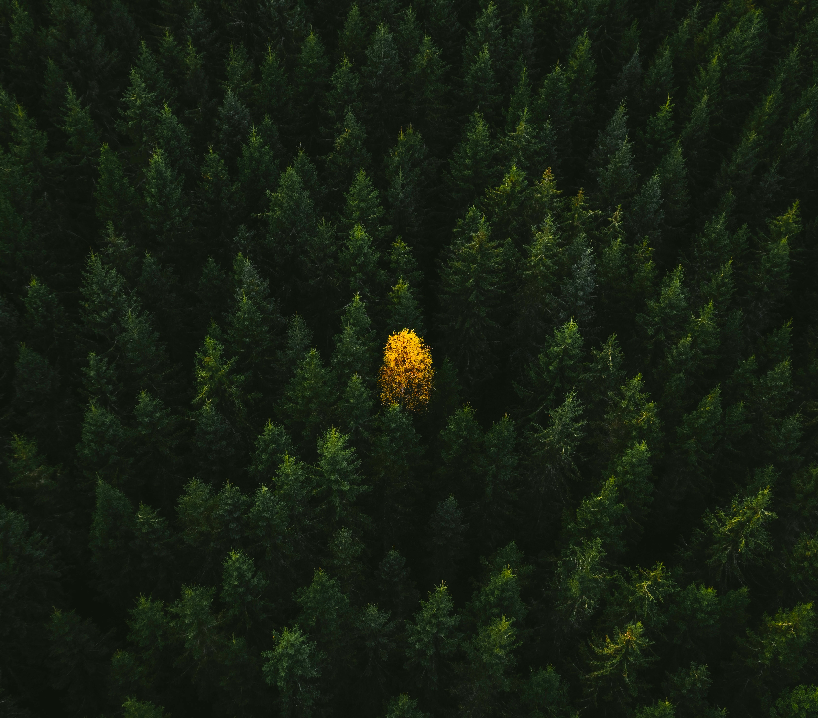
K-Nearest Neighbors Classifier
Neighboring Trees

Slide 10
K-Nearest Neighbors
Performance
Nearest Neighbor | 1 | 3 | 5 | 7
Mean Accuracy | 0.73380 | 0.70794 | 0.69947 | 0.68955
Standard Deviation | 0.00177 | 0.00237 | 0.00226 | 0.00259
Sklearn.KNeighborsClassifier was used, iterating through the n_neighbors attribute.
10-Fold Cross Validation was used.
Mean Accuracy and Standard Deviation taken from validation accuracy vector.
Best with one neighbor.

Slide 11
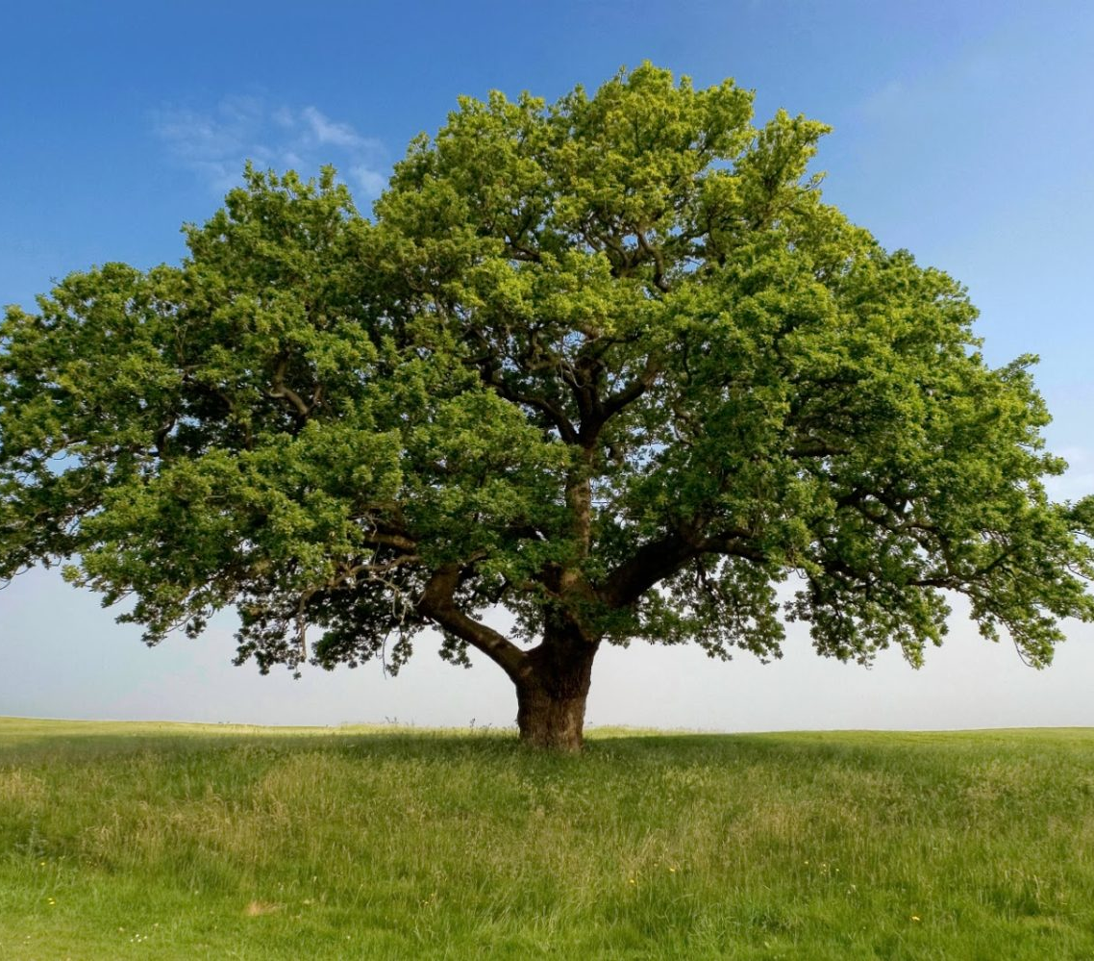
Decision Tree Classifier
Decisions, Decisions

Slide 12
Decision Tree
Performance
Max Depth | 5 | 15 | 30 | 100
Mean Accuracy | 0.60106 | 0.70417 | 0.70628 | 0.70628
Standard Deviation | 0.00570 | 0.00152 | 0.00172 | 0.00172
Sklearn.DecisionTreeClassifier was used, iterating though the max_depth attribute and stetting criterion to entropy.
10-Fold Cross Validation was used.
Mean Accuracy and Standard Deviation taken from validation accuracy vector.
Never seems to overfit.

Slide 13
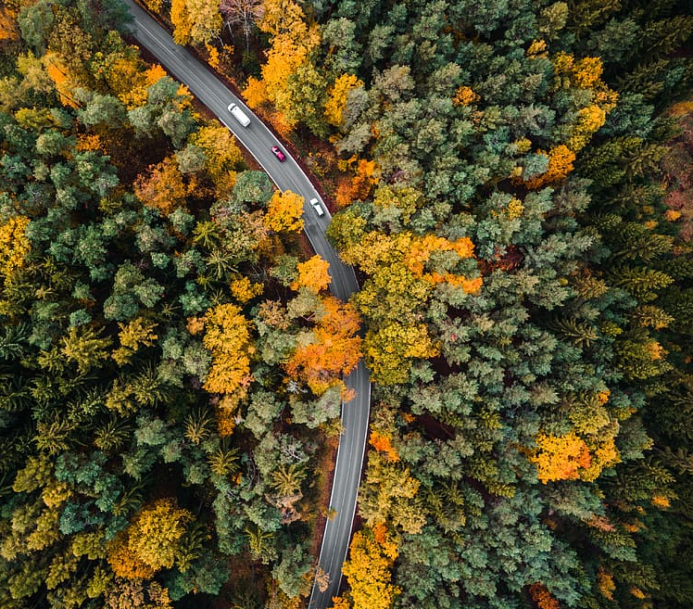
Random Forest Classifier
So many branches

Slide 14
Random Forest
Performance
Estimators | Max Depth | Mean Accuracy | Standard Deviation
5 | 5 | 0.56614 | 0.00417
 | 20 | 0.71429 | 0.00221
 | 50 | 0.73102 | 0.00266
20 | 5 | 0.61978 | 0.00441
 | 20 | 0.74749 | 0.00237
 | 50 | 0.76614 | 0.00213
50 | 5 | 0.63796 | 0.00471
 | 20 | 0.76025 | 0.00198
 | 50 | 0.77507 | 0.00226
100 | 100 | 0.78525 | 0.00204
Sklearn.RandomForestClassifier was used, iterating through the max_depth and n_estimators attributes and setting criterion to entropy.
10-Fold Cross Validation was used.
Mean Accuracy and Standard Deviation taken from validation accuracy vector.
Best accuracy and best deviation are not the same.

Slide 15
Summary
I was a bit disappointed in the cross-validation results. My initial findings had been more promising (85⁺%). The best score was 79% for random forest, followed by 73% for k-NN, then 71% for decision tree. I was surprised to see k-NN doing as well as it did for such a simple model.

Slide 16
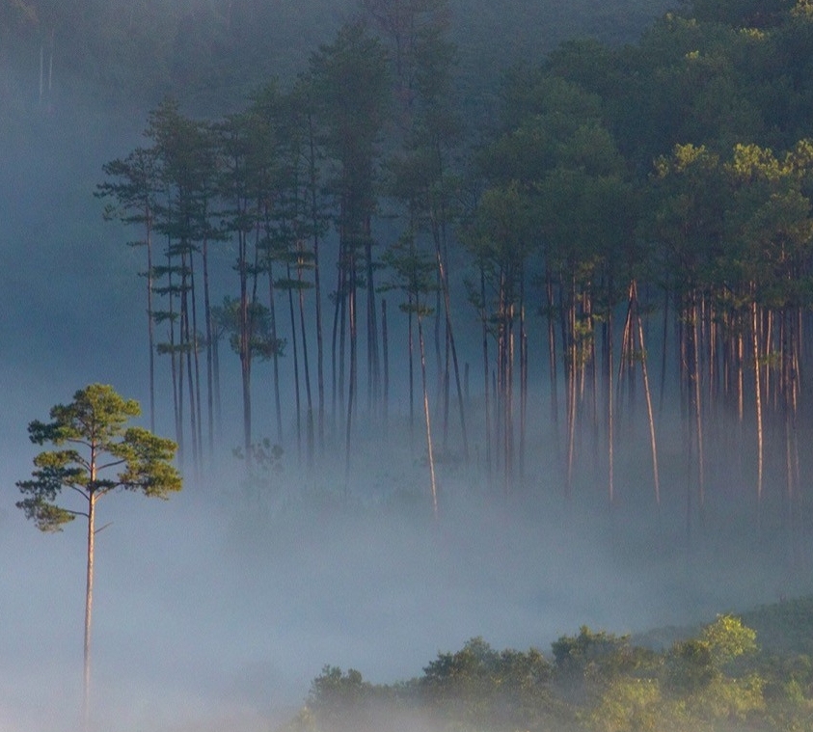
Thank you
Please ask any questions.
https://www.kaggle.com/c/forest-cover-type-prediction/data

